Slide 1
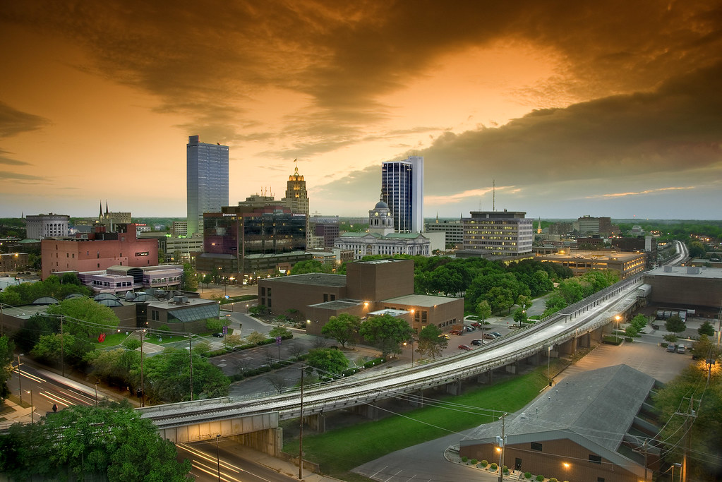

Fort Wayne Choice Neighborhoods
SEFW CNI Neighborhood
Implementation Process Informational
February 4th 2026

Slide 2
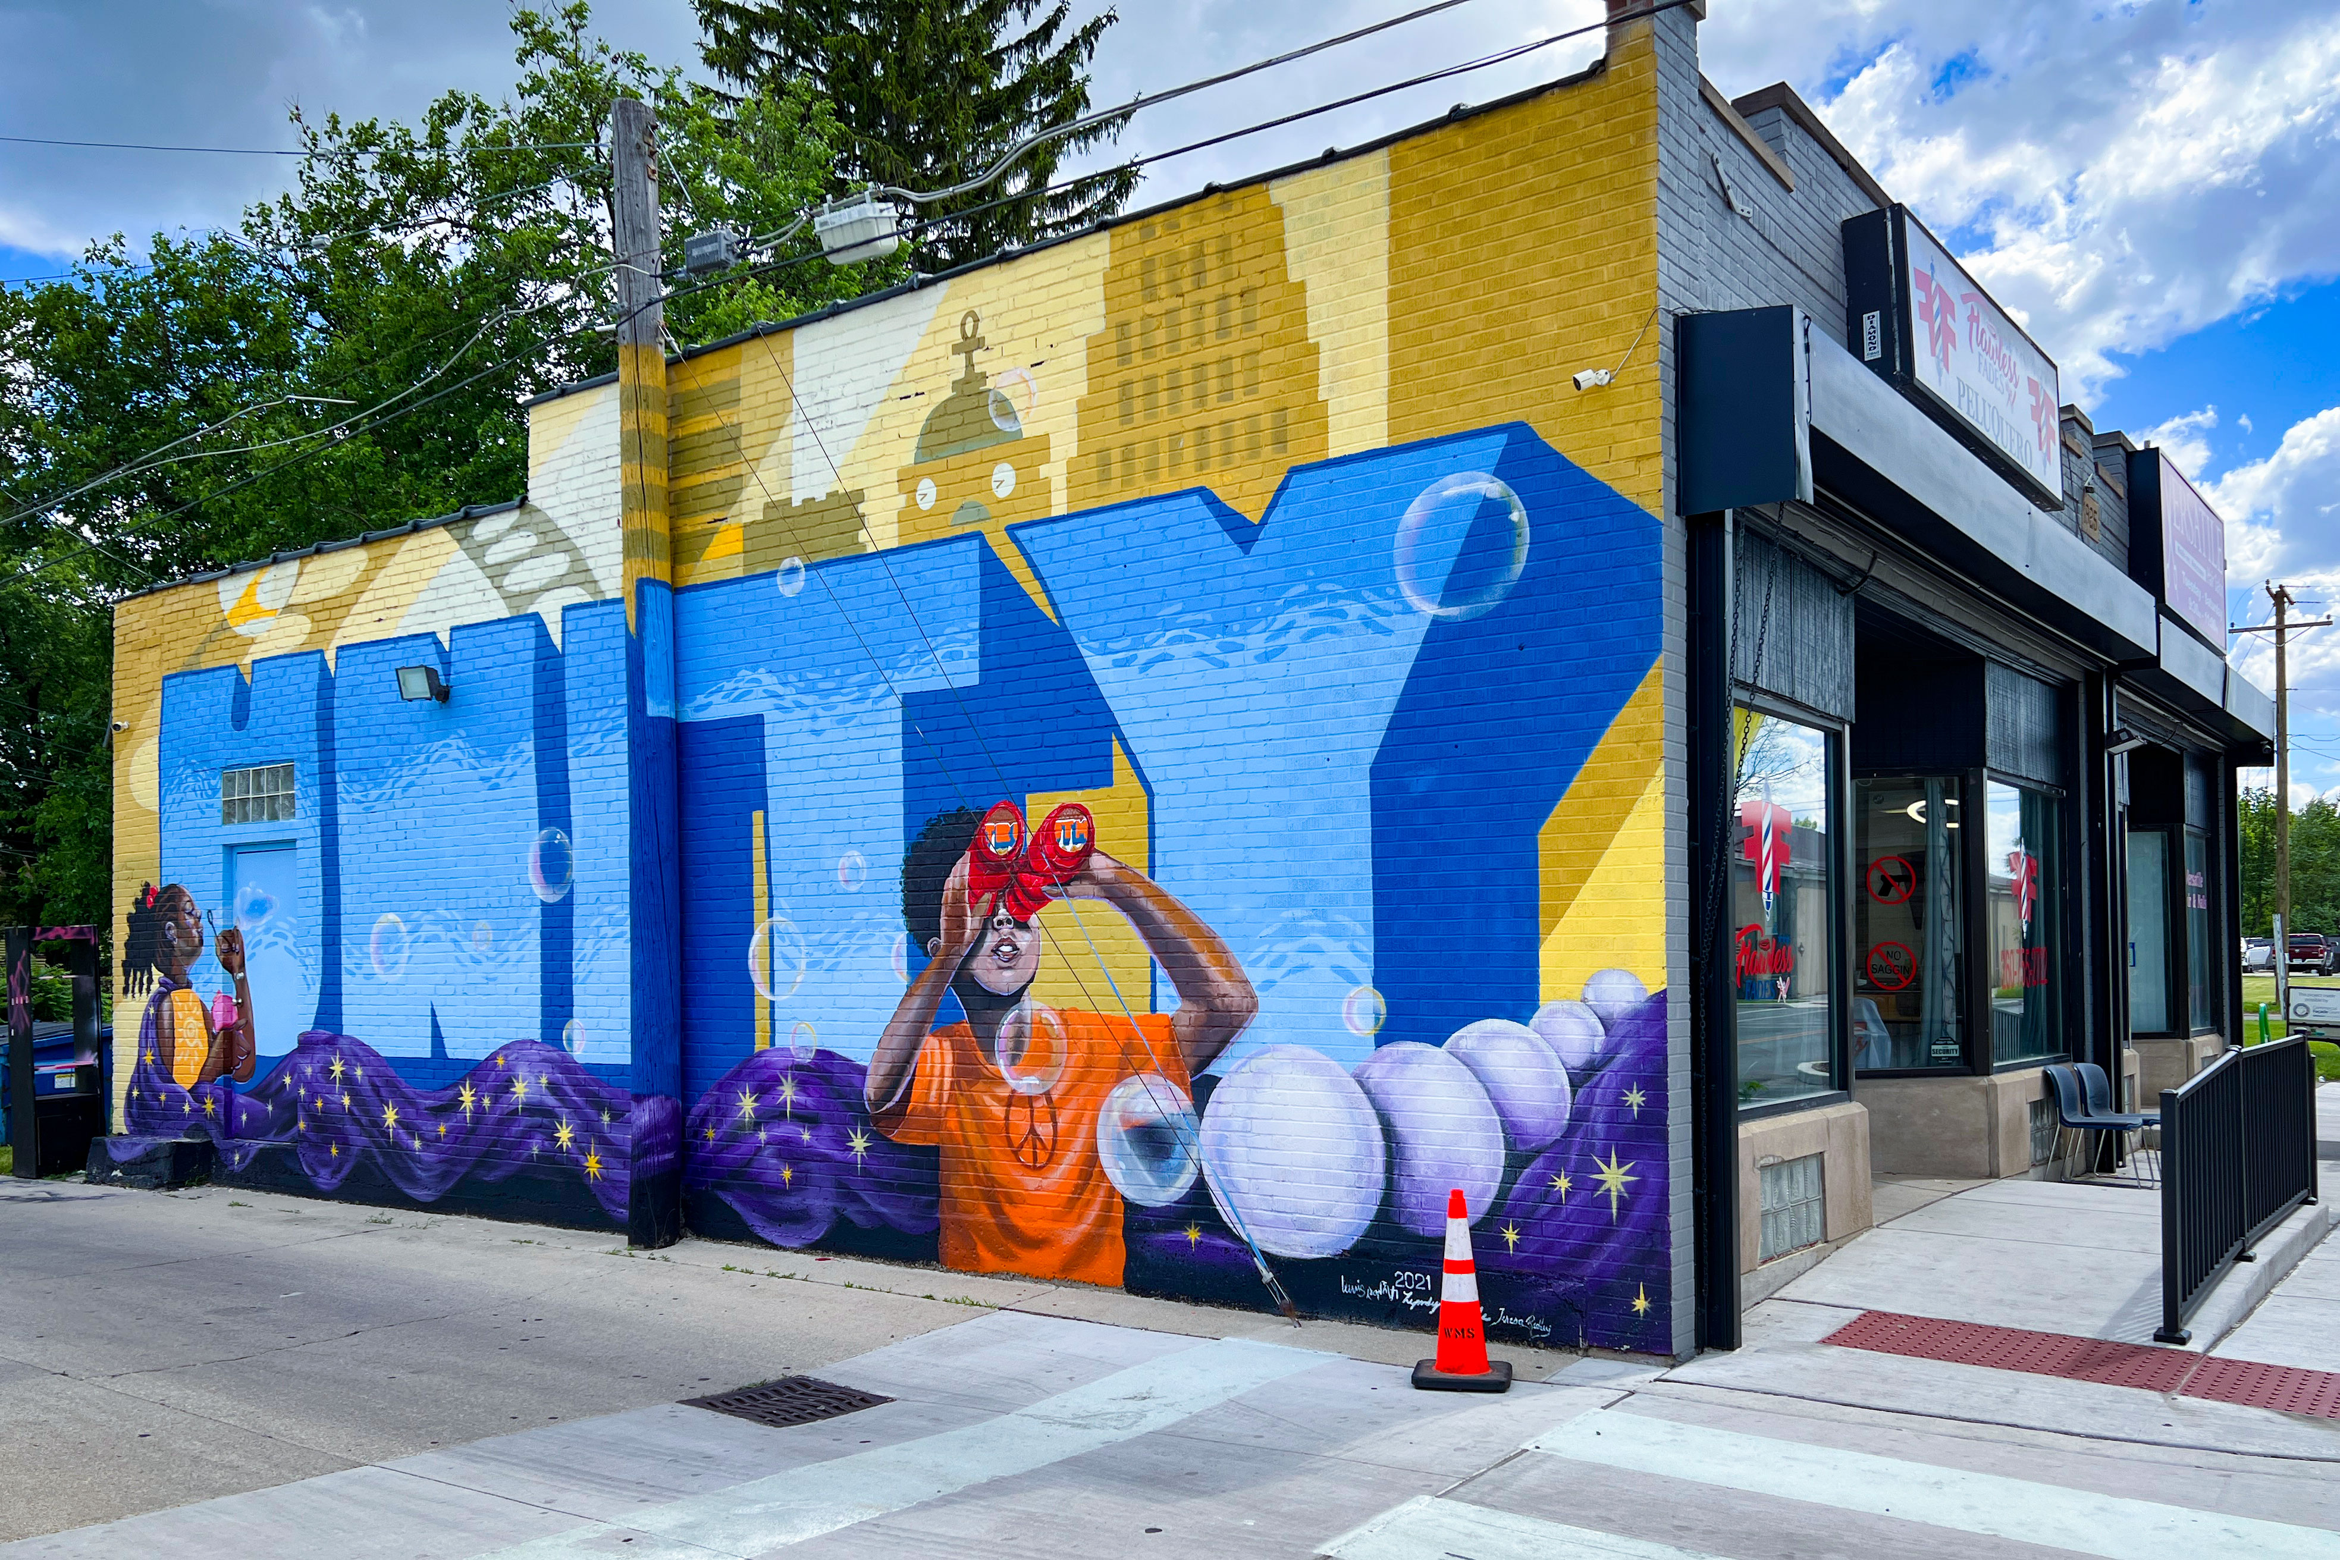
Agenda
Opening Remarks
Choice Overview
Transformation Plan Overview
Implementation Process
Next Steps

Slide 3
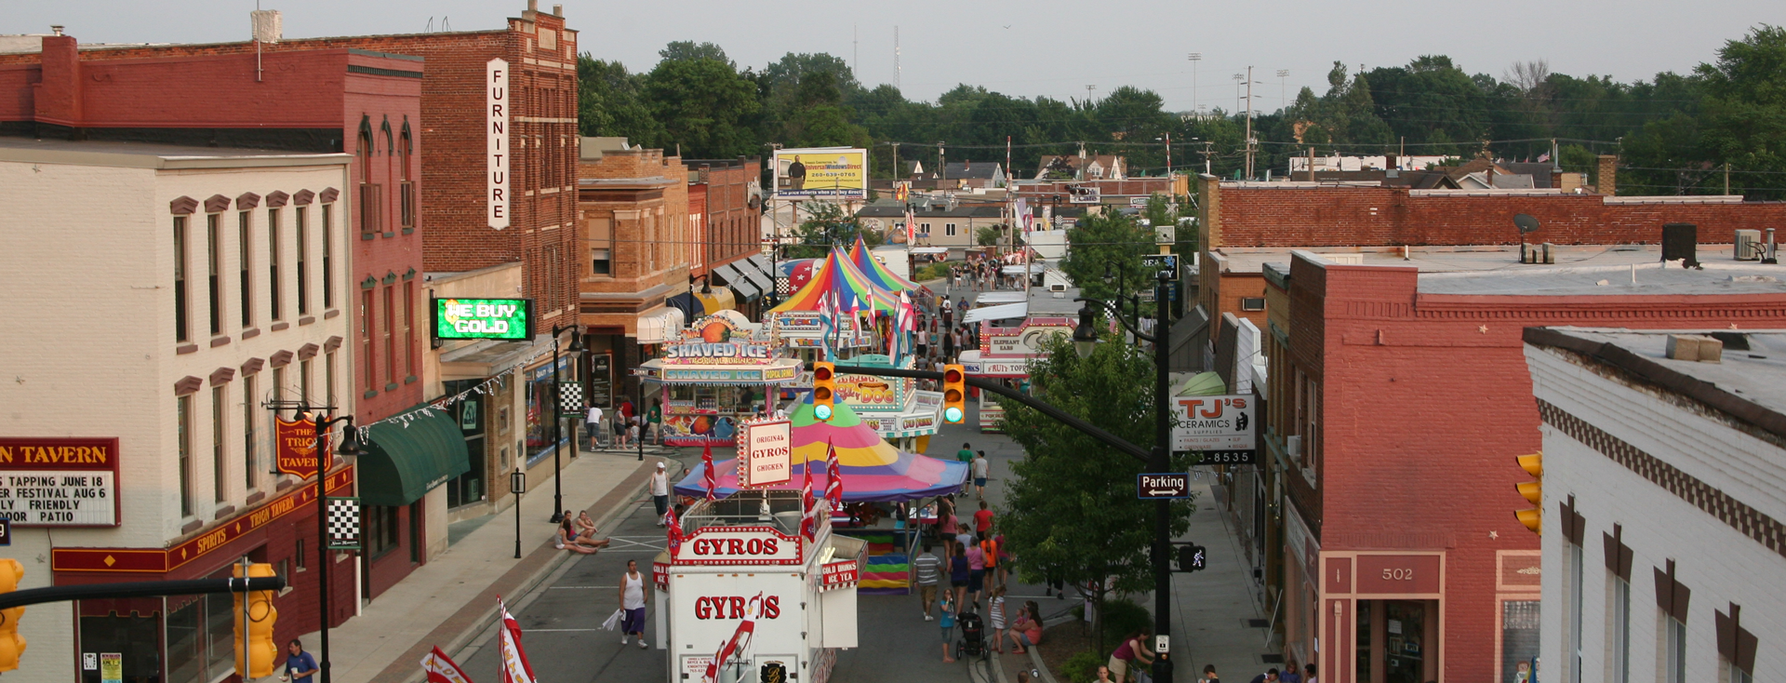
Opening Remarks

Slide 4

Choice Overview

Slide 5


CHOICE NEIGHBORHOODS
HUD’s Choice Neighborhoods program supports locally driven strategies to:
• Revitalize distressed public and assisted housing
• Improve access to housing, education, transportation, and economic opportunity
• Strengthen neighborhoods through coordinated investments
The program focuses on three core areas:
• HOUSING
• PEOPLE
• NEIGHBORHOODS

Slide 6
GRANT AWARDS
PLANNING GRANT*
• 30 months (2.5 years)
• $500,000
• Formulating the transformation plan
*Fort Wayne was awarded a Planning grant in 2022
IMPLEMENTATION GRANT
• 96 months (8 years)
• Up to $26,000,000
• Implementing the transformation plan

Slide 7
Transformation Plan Overview

Slide 8
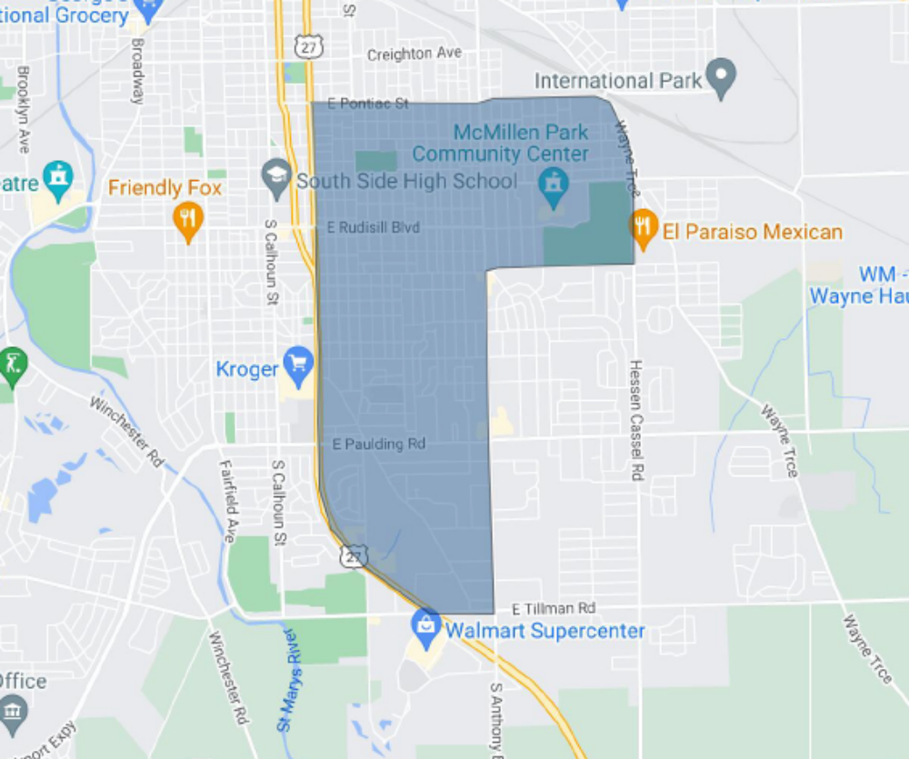
SEFW CNI NEIGHBORHOOD
Northern Boundary
  E Pontiac St.
Southern Boundary
  E Tillman Rd. & McKinnie Ave.
Eastern Boundary
  Wayne Trce./Hessen Cassel Rd.
Western Boundary
  Lafayette St. (US Hwy 27)
  Tall Oaks Apartments

Slide 9
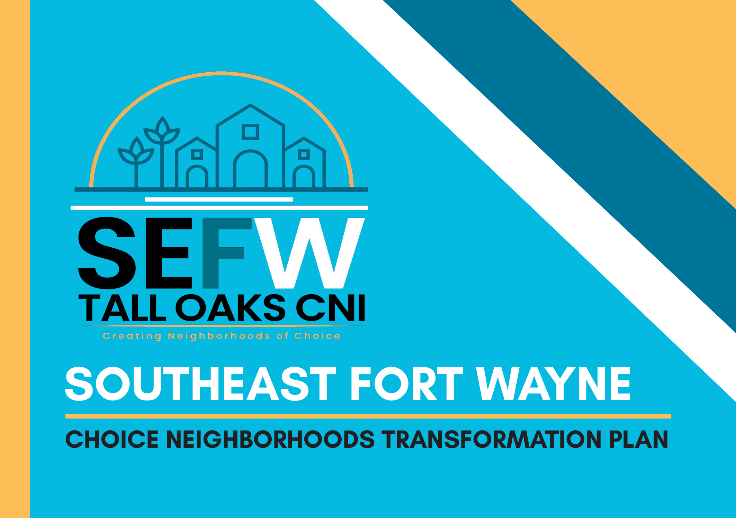
TRANSFORMATION PLAN
Approved by HUD
August 2025

Slide 10
PLAN VISION
CREATING A NEW LEGACY THAT PROMOTES COMMUNITY, AFFORDABILITY, ACCESSIBILITY,
AND OPPORTUNITY FOR ALL!

Slide 11
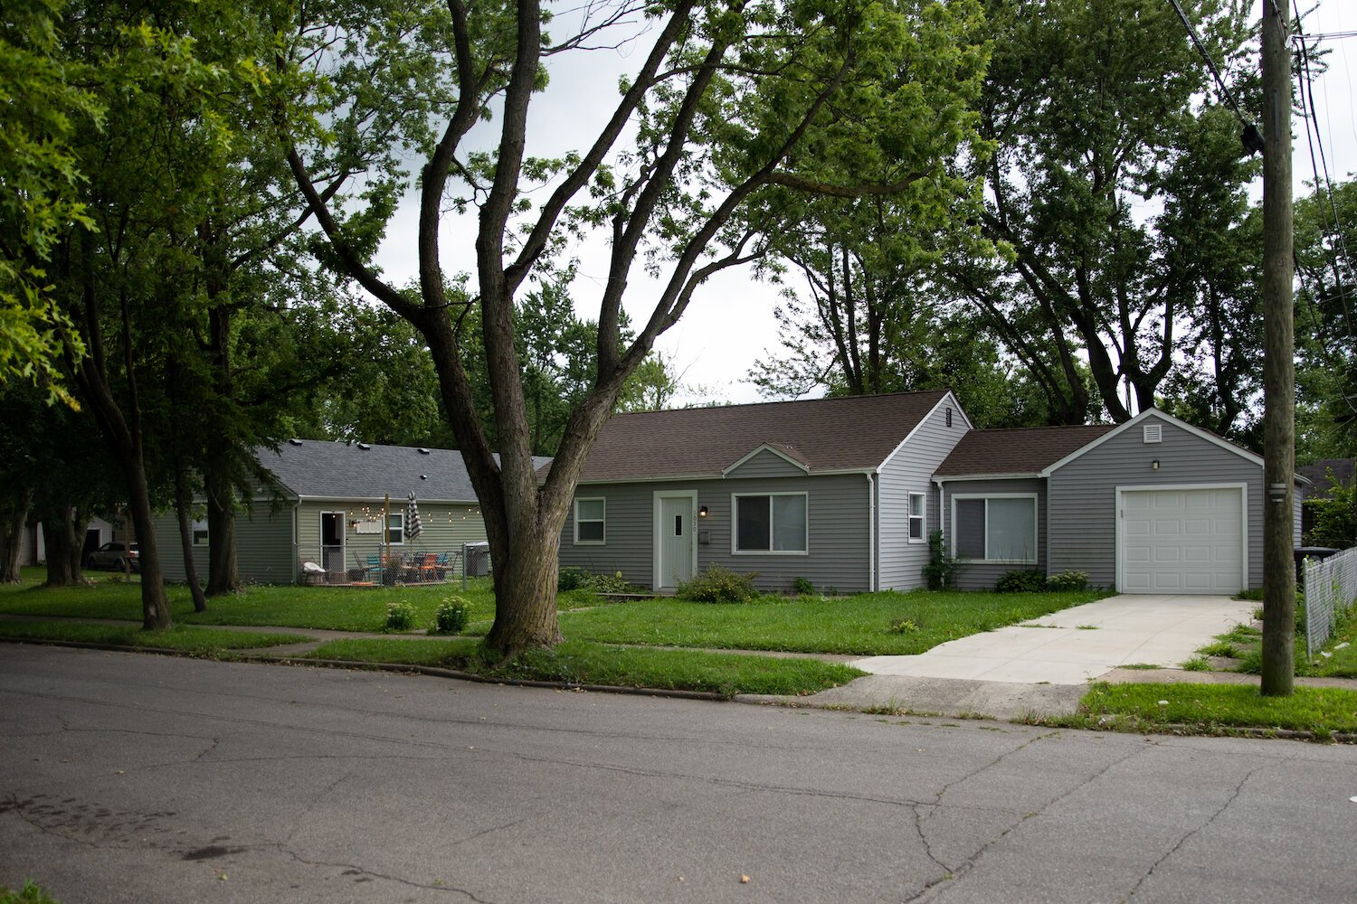
HOUSING PLAN GOALS
GOAL 1. PROVIDE MORE DIVERSE HOUSING OPTIONS
GOAL 2. HOMEOWNERSHIP PROGRAM AWARENESS AND EXECUTION

Slide 12
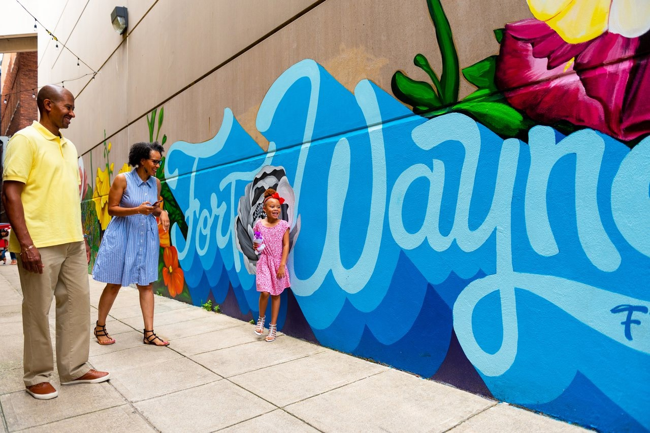
PEOPLE PLAN GOALS
GOAL 3. IMPROVE ACCESS TO QUALITY EDUCATION FOR ALL AGES
GOAL 4. EXPAND ADULT EDUCATION AND SKILL DEVELOPMENT OPPORTUNITIES
GOAL 5. PROVIDE POSITIVE AND ENGAGING OPPORTUNITIES FOR YOUTH
GOAL 6. FOSTER YOUTH EMPLOYMENT AND CAREER READINESS
GOAL 7. ENHANCE ACCESS TO HEALTH AND WELLNESS SERVICES

Slide 13
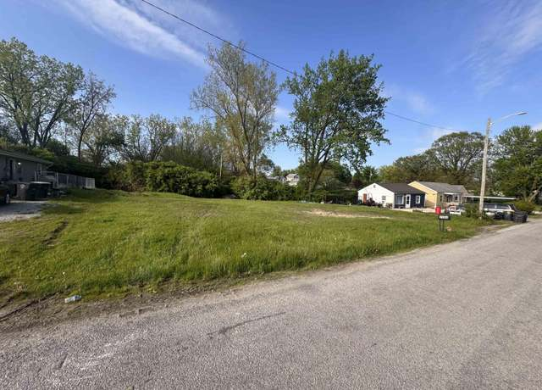
NEIGHBORHOOD PLAN GOALS
GOAL 10. IMPROVING POLICING AND SECURITY EFFORTS
GOAL 11. IMPROVE ACCESS TO DISABILITY-FRIENDLY ROUTES
GOAL 12. ACCESS TO ALTERNATIVE OPTIONS FOR MOBILITY AND CONNECTIVITY
GOAL 13. ENCOURAGE RESPONSIBLE LAND USE AND ENERGY PRACTICES

Slide 14
Implementation Process

Slide 15

APPLICATION: IMPORTANT INFO
  Due Date
  March 9, 2026
  Available Funding
  $75,000,000
  Highest Request
  $26,000,000
  Expected Awards
  Four (4)

Slide 16
APPLICATION: FUNDING
  HUD Choice Grant Funds Coverage
  Replacement Housing - 75%
  Supportive Services - 15%
  Critical Community Improvements* - 10%
  Other funding sources will be sought out to implement the plan fully.
  *Grant-funded, physical community and economic development projects that advance the neighborhood outcomes proposed in the Transformation Plan.

Slide 17
POST-AWARD: OUTCOMES
  If awarded, the Implementation Grant would support:
  Phased redevelopment or rehabilitation of housing
  Continued resident and community engagement
  Partnerships with local organizations and agencies
  Community cohesion and growth

Slide 18
INVOLVEMENT
  How can Residents and Partners stay involved throughout the Implementation process?
  Ongoing engagement through meetings and feedback
  Program and service delivery
  Leverage contributions (cash and/or in-kind support)
  Providing data and local knowledge
  Community outreach and communication
  Monitoring progress and outcomes

Slide 19
Next Steps

Slide 20
UPCOMING MILESTONES
  Submit application
    March 9th 2026
  Complete Early Action Activity
    June 2026
  *Dates are subject to change.

Slide 21
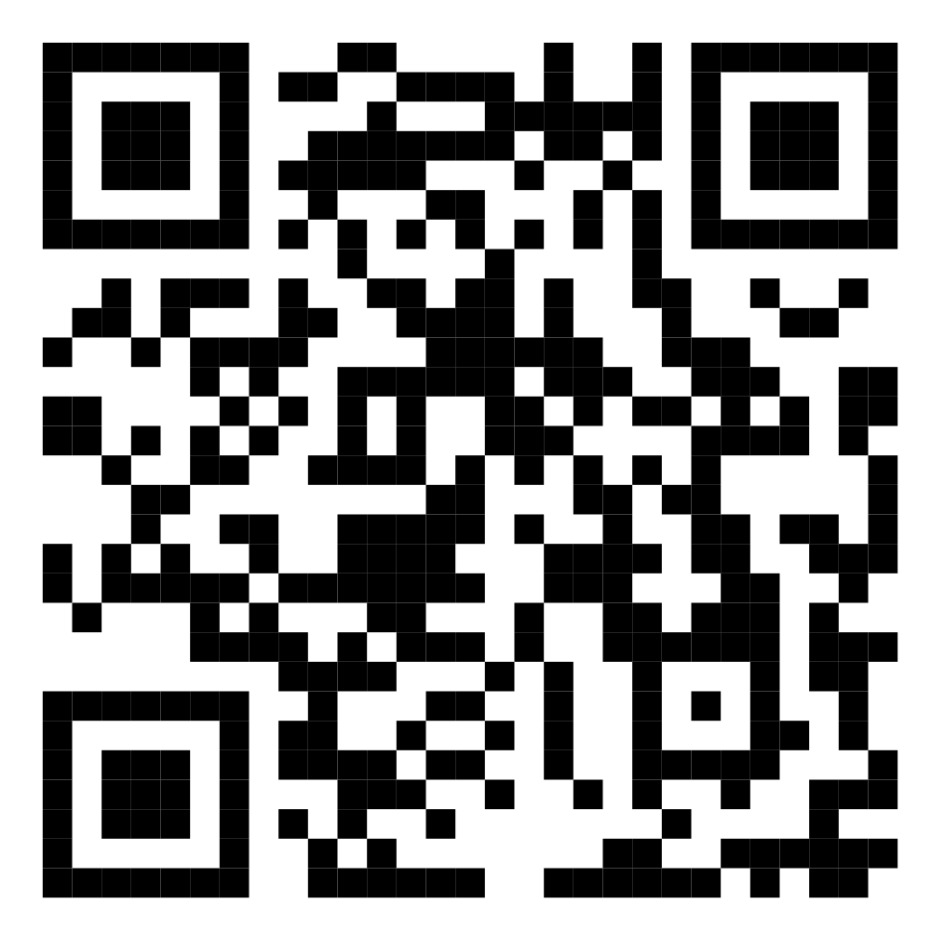
FEEDBACK

